Slide 1

S.T.I. HEALTH EDUCATION
RUGENDO.M.M. (MR)

Slide 2
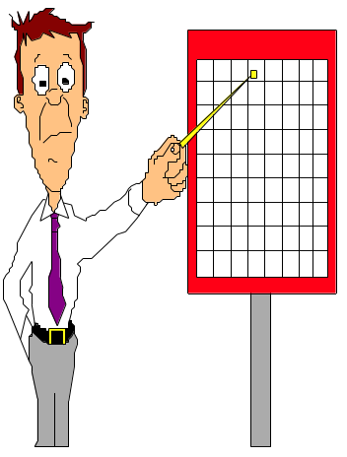
Definition:
“Health education is the process by which individuals and group of people learn to “:
Promote
Maintain
Restore health.
“Education for health begins with people as they are, with whatever interests they may have in improving their living conditions”.

Slide 3
Health education cont’
Health education is defined as:
Process which affects changes in the health practices of people and in the knowledge and attitude related to such changes.
Teaching process providing basic knowledge and practice of health, so as to be interpreted into proper health behavior.
Any combination of learning experiences designed to facilitate voluntary adaptation of behavior conducive to health”.

Slide 4
Aims/objectives of Health education
Health promotion and STI prevention.
Early diagnosis and management of STI.
Utilization of available STI health services.
To make health an assest valued by the community.
To increase knowledge of the factors that contribute to STI.
To encourage behavior change and modification which promotes STI risk reduction .
To enlist support for public health measures, and when necessary, to press for appropriate governmental action on matters relating to STI.

Slide 5
Aims of Health education cont’
To encourage appropriate use of RH health services especially STI preventive services.
To inform the public about medical advances, their uses and their limitations

Slide 6
Steps in Adoption of new ideas or practice
Awareness (know)
Interests (details)
Evaluation (Advantages Vs Disadvantages)
Trial (practices)
Adoption (habit)

Slide 7
Stages for health education
Stage of Sensitization
Stage of Publicity
Stage of Education
Stage of Attitude change
Stage of Motivation and Action
Stage of Community Transformation (social change)

Slide 8
Principles of Health education
Interest.
Participation.
Proceed from known to unknown.
Proceed from simple to complex concepts
Comprehension.
Reinforcement by repetition.
Motivation
Clarity of the objectives
Relevance of the material

Slide 9
Principles of Health education
Learning by doing
People, facts and media.
Good human relations
Good Leadership

Slide 10
Approaches to health education
persuasion approach –The deliberate attempt to influence the other persons to do what we want them to do (DIRECTIVE APPROACH)
The informed decision making approach-giving people information, problem solving and decision making skills to make decisions but leaving the actual choice to the people.

Slide 11
Targets for S.T.I health education
Individuals such as clients of services, patients, healthy individuals
Groups E.g. groups of students in a class, youth club
Community E.g. people living in a village
MARPs

Slide 12
S.T.I Health education Settings
Communities
Health care facilities
Work sites
Schools
Prisons
Refugee camps …etc

Slide 13
People responsible for S.T.I health education
Health extension workers
Nurses
Clinical officers
Medical doctors
Chew
Etc.

Slide 14
Communication in S.T.I health education.
Types of communication:-
      One- way communication
      Two –way communication

Slide 15
One –way communication
This is a linear type of communication in which information flows from the source to the receiver.
There is no feed back from the receiver.
It is commonly used in advertising; the message is designed to persuade the receiver to take action prescribed by the sender.
The model is best used by organizations when the message is simple and needs to be communicated quickly, for example, the date and time of a public meeting.
There is no opportunity to clear up misunderstanding and meaning is controlled by the receiver.

Slide 16
Two- way communication
In this type of communication, information flows from the source to the receiver and back from the receiver to the source.
The addition of feedback allows the sender to find out how the message is being received and so it can be monitored and adapted to better suit the receiver’s needs.

Slide 17
Good communication technique
Source credibility.
Clear message.
Good channel: individual, group & mass education.
Receiver: ready, interested, not occupied.
Feed back.
Observe non-verbal cues.
Active listening.
Establishing good relationship.

Slide 18
Components of communication
Communicator: the person or the team give the message (Educator/source).
Message: the contents (materials) of health education
Channel: method of carrying the message
Audience: the receivers (users or targets) of the message

Slide 19
Components of communication cont’
Source (sender)
Originator of message
Can be from an individual or groups, an institution or organization.
People are exposed to communication from different source but most likely to accept a communication from a person or organization that they trust i.e. has high source credibility.

Slide 20
Components of communication cont’
Depending on the community, trust and source credibility may come from:
Personal qualities or actions e.g. a health worker who always comes out to help people at night.
Qualification and training
A person’s natural position in the family or community, e.g. village chief or elder.
The extent to which the source shares characteristics such as culture, education, experiences with the receiver.

Slide 21
Components of communication cont’
Message
It consists of what is actually communicated including the actual appeals, words, and pictures and sounds that you use to get the ideas across.
A message will only be effective if the advice presented is relevant, appropriate, and acceptable and put across in an understandable way.

Slide 22
Message cont’
A message is said to be good if it:
Is Epidemiologically correct (evidence based)
Is affordable (feasible)
Requires minimum time/effort
Is realistic
Is culturally acceptable
Meets a felt need
Is easy to understand

Slide 23
Components of communication cont’
Channel
A Channel is a physical means by which message travels from a source to a receiver. The commonest types of channels are verbal, visual, printed materials or combined audio visual and printed materials.
Your choice of channel will depend on what you are trying to achieve, the nature of your audience and what resources are at your disposal.

Slide 24
Components of communication cont’
Receiver (Audience)
The person or a group for whom the communication is intended
The first step in planning any communication is to consider the intended audience.

Slide 25
Receiver (Audience) cont’
Before communication, the following characteristics of audiences should be analyzed:-
Educational factors: can they read? What type of peoples might convince them?
Socio-cultural factors: What do they already believe and feel about the topic of communication?
Patterns of communication: how people show respect when talking to another person? What time of the day and which programs do they listen?
Which places do they pass that might be good places to put up posters?

Slide 26
Components of communication cont’
Effect and feedback
Effect is the change in receiver’s knowledge, attitude and practice or behavior.
Feedback is the mechanism of assessing what has happened on the receiver after communication has occurred.

Slide 27
Process of communication
Sender
receiver
reaches the senses
Gain attention
message understand
Acceptance/change
behaviour change
Health change

Slide 28
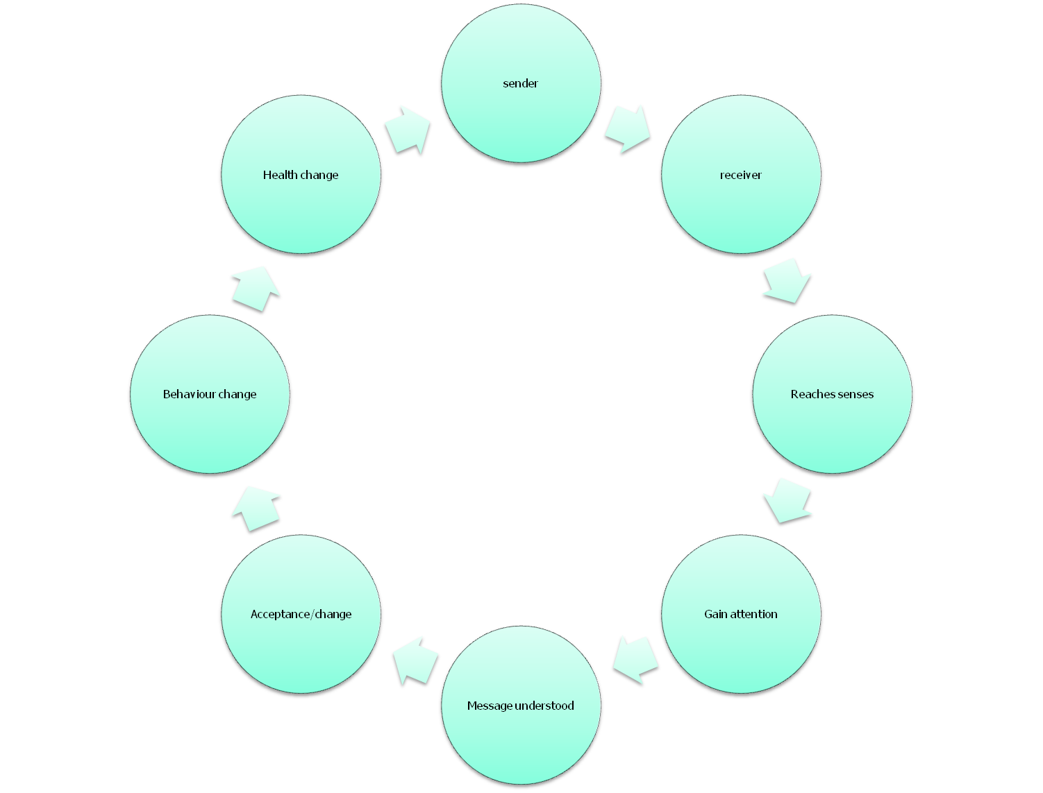

Slide 29
Reasons for effective communication in S.T.I health education
To have dialogue with communities.
Influence decision makers to adopt health promoting policies and laws.
Raise awareness among decision makers on issues regarding S.T.I and reproductive health
Ensure that the public gives support to government health promoting activities.
Communicate new laws and policies to the public
Raise public awareness in order to mobilize community participation.
Develop community action on S.T.I health issues.

Slide 30
Educator
Personnel of health services.
Medical students, nursing & social work.
School personnel.
Community leaders & influential.
Requirements:
Personality: popular, influential and interested in work.
Efficiency trained and prepared for the job.
Must show good examples.

Slide 31
Roles of a health educator
Assess individual and community needs
Plan health education programs
Develop health education programs
Coordinate health education programs
Implement health education programs
Manage health education programs & personnel
Evaluate health education programs

Slide 32
Roles of a health educator
Build coalitions
Identify resources
Make referrals
Develop social marketing and mass media campaigns
Organize/ mobilize communities for action

Slide 33
Roles of a health educator
Handle controversial health issues/content
Advocate for health related issues
Encourage healthy behavior
Use a variety of education/training methods
Develop audio, visual, print and electronic materials

Slide 34
Characteristics of a good health educator
  Good communication skills
  Good planning skills in content delivery
  Organize learning materials well
  Provide advice and information
  Enthusiastic
  Use assessment to give feedback that modifies learning
  Should be confident in delivery of the subject matter
  Use of variety of teaching methods
  Should be able to relate teaching with learner’s experiences

Slide 35
Message
What information to be communicated.
Simple, at the level of understanding.
Culturally accepted.
Interested.
Meet a felt need.
Avoid technical jargon.
Use audiovisual aids.

Slide 36
Communication Barriers
Social and cultural gap between the sender and the receiver
Limited receptiveness of receiver
Negative attitude of the sender or recipient
Limited understanding and memory
Insufficient emphasis by the sender (health professional)
Contradictory messages
Health education without identifying the “needs "of the community

Slide 37
Teaching methods
Lecture
Practical
Field excursions
Demonstration
Seminar
Workshop
Case study
Tutorial
Project
Group discussion
Simulation
Role play
Interview
Counselling

Slide 38
Teaching Aids
Teaching is more effective when more than one sense is used.
Multisensory approach improves retention which is vital in learning process.
The commonest aids are audio-visual where senses of seeing and hearing are combined.
Teaching aids can be classified into two:
    Projected aids
    Non projected aids

Slide 39
Projected Aids
Projected aids include:
  Overhead transparency (projector).
  Films.
  Video cassettes.
  Slides.

Slide 40
Non-projected Aids
These include:
  chalkboard
  pictures
  cartoons,
  flipcharts
  posters
  handouts
  flannel boards.

Slide 41
Factors influencing learning
Socio-economic factors
Language barrier
Socio-cultural factors. e.g. age
Learners factors e.g. willingness to learn
Educator’s factors. e.g. willingness to help the learner understand
Presentation .i.e. clarity of the objectives, organization of content,

Slide 42
